Slide 1
SEND Information Report
2025-26

Slide 2

Rooted in the values of its namesake, Alfred Salter Primary School stands at the centre of the community, with compassion and inclusivity at its heart. The school seeks to provide an abundance of opportunities and life experiences for each and every child: unearthing passion, nurturing talent and growing fulfilled individuals.
‘The school provides staff with information about those pupils with additional needs…..Teachers use this to make effective adaptations, particularly for those with special educational needs…’ (Ofsted, 2024)
What are Special Needs and Disabilities (SEND)?
At different times in their school life, a child or young person may have a special educational need. The Code or Practise 2014 defines SEND as follows: ‘A child or young person has SEND if they have a learning difficulty or disability which calls for special education provision to be made for him or her.
A child or compulsory school age or a young person has a learning difficulty or disability if he or she: Has a significantly greater difficulty in learning than the majority of others the same age, or has a disability which prevents of hinders him or her from making use of facilities of kind generally provided for others of the same age in mainstream schools or mainstream post-16 institutions. Children whom have an area of need or a delay in 1 or more of the following areas: · Communication and interaction. · Cognition and Learning. · Social, emotional and mental and sensory/ physical.
Key Contacts:
Adam Bridle
Deputy Head for Inclusion
Abigail Townley
SENCO
Lisa Ascott
Specialist Learning Assistant: Curriculum Access
sen@alfredsalter.com

Slide 3



How accessible is this school for my child?
Our school is a two storey, purpose-built two form entry school – We have wide corridors inside the building, lift access to the first floor and an equipment storage room for wheelchairs, standing frames, etc.
We are fully wheel-chair accessible, we have a toilet for people with disabilities and we ensure that equipment and adaptations are put in place to support each child’s individual needs.
Our classrooms are communication friendly and some staff are trained to use Makaton (a key word signing approach) to support children who do not use speech to communicate
We have a calm zone for children who are either over or under-stimulated and who benefit from sensory experiences as part of their learning.
Our playground equipment has been specially painted to support play and leaning or children with visual impairments
Classrooms are equipped with sound field systems which help all children listen but can be of particular benefit to pupils with a hearing impairment.
The school’s accessibility policy can be requested via the school office or sen@alfredsalter.com
How will my child be welcomed into the school?
Transition – both into school and from Alfred Salter to other schools –is an exciting time for families, but can raise some concerns too. To help children feel welcome:
The school office staff arranges tours of the school for prospective new children and their families
Adam also meets with the child and parent/carer where appropriate; and if the child has been attending another setting, he tries to arrange a transition meeting with the previous school.
Our Reception class teachers host an open morning in the summer term for parents/carers to come along and meet the teachers and find out more about classroom routines
The school provides transition books for the summer break with photos of the school and key staff so parents/carers can use these with their child, where such an approach would be beneficial in helping the settling in period.
If you would like to find out more about admissions to Alfred Salter, please contact the school office.
How will the school help my child manage the transition into a new class?
A staff meeting is allocated for class teachers to share key information about the children in their class, including differentiation strategies, successful behaviour management strategies and your child’s strengths and needs.
Adam will schedule transition meetings for pupils with complex needs, this is a chance for the new teacher to meet the parents and ask questions.
The school provides transition books for the summer break with photos of the school and key staff so parents/carers can use these with their child, where such an approach would be beneficial in helping the settling in period.

Slide 4




How do you assess and review children and young people’s progress towards outcomes?
The progress of SEND students is closely monitored and data and reports are released and assessed termly during the autumn, spring and summer term, this is recorded and monitored closely, with interventions being established and added where students need extra support in their learning. Adam Bridle is available during parent’s evenings to share the data and discuss progress with the parents/carers.
What is your approach to teaching children and young people with SEND?
Approaches and strategies for teaching children and young people with SEND include high quality teaching by all staff. The curriculum across all year groups is broad and balanced for all students. Classwork is personally differentiated and tailored for students with SEND so they can access the national curriculum. There are opportunities for students to work in smaller groups, as well as 1:1 extra support with support staff. Some children access individualised curriculums designed by Cherry Gardens Special School.
How are adaptations made to the curriculum and the learning environment of children and young people with SEND?
Classwork is differentiated for children with SEND in order for them to access the curriculum. Examples of this include the use of visual aids, modified learning objectives and outcomes, and staggered workloads. A variety of resources are supplied and used in class to help students achieve, these include, visual prompts, vocabulary lists, to-do-lists, then and next boards, etc.
How are staff trained to support students with SEND?
All staff have received in-house INSET training for SEND. SEND training by outside agencies such as speech and language therapists and educational psychologists are also organised. Support staff have received regular SEND training, and the department receives regular outreach support from external providers detailed in this report. Adam Bridle (Deputy Head) holds the National SENCO Award from University College London (Institute of Education) and is a Specialist Leader of Education (SEND).
How do we consult young people with SEND and involve them in their education?
Students are involved in their own learning by their attendance at person centred reviews, and being given regular student voice opportunities. Teachers and staff encourage consistent lesson feedback, in order to get students communicating and making suggestions on how to improve their learning experience. SEN students are also offered key sessions with the learning mentor to discuss any concerns they have and their opinions on how best we can support their needs. There are also opportunities for SEN students to be on the school council to voice their views.

Slide 5




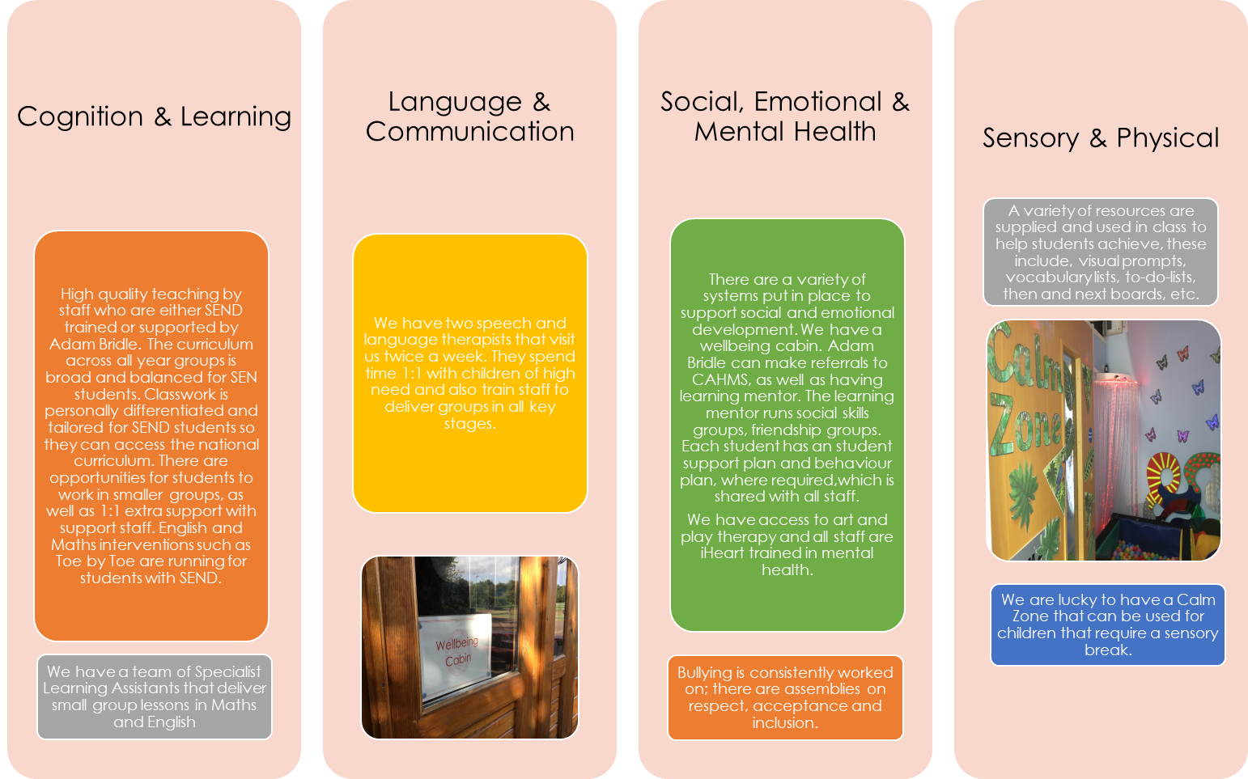
What support is on offer at Alfred Salter Primary?

Slide 6
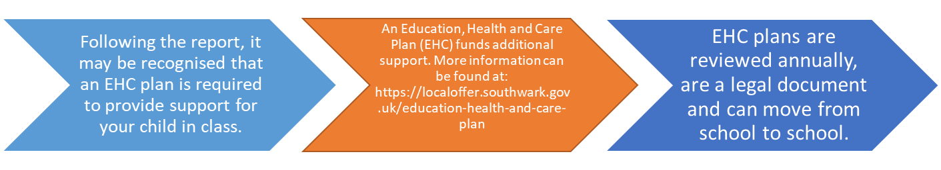


Alfred Salter Primary School’s SEND Supporting Partners.
We work with many supporting partners in school including:
Community Paediatricians
Physiotherapists
Occupational Therapy
Hearing & Visual impairment services.
CAMHS – Child/adolescent Mental Health Service
Speech and Language Therapy provided by:
https://www.sarahbuckleytherapies.co.uk/
Cherry Gardens School outreach
Southwark ASD team
Educational Psychologists.
Specialist teams from Evelina Children’s Hospital.
What if I disagree with some aspect of the plan (EHC), or I disagree about the council’s SEND department conducting the assessment?
The best thing for you to do is to talk to the local authority about why they have made the decision they have. The Parent Partnership Service are also available to help you, and there are routes you can go down if you remain dissatisfied – please see the relevant local authority’s procedures for this.

Slide 7


How will the school fund the support needed for my child?
Part of the school’s budget has been allocated to help it meet the needs of pupils with SEND. At Alfred Salter we manage these resources effectively and try to ensure that pupils receive adequate support to help them make progress. Most EHC plans provide the school with an allocation of financial support. This can be discussed at the child’s annual review meeting.
How are decisions made about funding and what can I do if I’m unhappy with this?
Governors set the budget at this school and Adam’s reports regularly to the governing body on how resources are deployed.
How will the school help my child manage the transition to secondary school?
A member of the Inclusion Team will liaise with the SENCO of your child’s new school, organising a transition meeting if necessary. Your child will be invited to attend all or part of the meeting as appropriate.
As necessary and if the secondary school is in agreement, a familiar member of the support staff team will attend additional taster days with your child.
How will my child manage tests and exams?
Continuous monitoring of each child’s progress gives a clear picture of how each child is progressing. Teachers at Alfred Salter use a range of assessment methods to determine what has been remembered, what skills have been acquired and what concepts have been understood. The outcomes of our assessments will help children become involved in raising their own expectations, celebrating their own achievement and increasing their self-motivation.
Ongoing formative assessment is carried out by teachers both formally and informally during a unit of work. The results of formative assessment have a direct impact on the teaching materials and strategies employed immediately following the assessment. Results and observations are kept in teachers own assessment folder and in children’s books/folders. If your child has been identified as having SEND and is making small steps of progress Adam and your child’s class teacher may decide it is necessary to create a learning portfolio, documenting their achievements and progress across the curriculum.
Summative assessments (tests) occur at defined periods during the academic year such as pre-determined SATs tests and other strategic tests implemented at different key stages. Summative tests are used alongside teacher assessment to help teacher in making end of year and end of key stage assessments. Class teachers ensure those with SEND access suitably differentiated tests and have additional time if required. In Year 6 prior to SATs assessments a decision will be made with you about whether or not it is appropriate for your child to participate. Adam will then determine whether any pupils with SEND require a reader, scribe and/or additional time to access the tests.

Slide 8


Where can I or my child get further help, information and support?
The first port of call is your child’s class teacher or DHT for Inclusion- Adam. The school website is also regularly updated, and is an important source of information for parents/carers, as well as links to other helpful sites – make sure your regularly check in for updates!
There are local drop-in services for parents/carers for children with SEND (e.g. the drop-in at Sunshine House Child Development Centre on Friday mornings)
Please speak email Adam or Sharon if you would like further information on drop-in services
What extra-curricular activities can my child participate in?
We do not discriminate against children with SEND, and all extra-curricular opportunities available for children without additional needs are available to those children with SEND. We have a range of after-school clubs at Alfred Salter. If you feel that your child requires additional support to access a club that they would like to attend, please speak to your child’s class teacher or email Adam. Lots of our children who are wheelchair users have accessed and really enjoyed the after-school provision at Alfred Salter. We strongly encourage all children to participate in school trips and school journeys – these are an important part of your child’s time at Alfred Salter. School trips are all risk assessed and we ensure there are appropriate measures taken to ensure all children’s safety and well-being when off-site. Again, if you have any concerns about your child going on school trips and school journey, please speak to your child’s teacher or email Adam.
How do I complain if I am not happy with what is happening for my child?
We hope that every parent/carer is happy with what is in place for their child. If you have anything you are not sure about, or have a concern with, the first thing to do is always discuss this with your child’s class teacher. In most instances, issues are resolved at this stage. However, if you remain unhappy you can also speak to Adam, a member of the Senior Leadership Team or the Head Teacher (Elli Prestage). There is a copy of the school’s complaints procedure available from the school office.
Enquiries into the school’s offer can be made to sen@alfredsalter.com or office@alfredsalter.com
Adam Bridle—Autumn 2025

Slide 9


